Slide 1
Autonomous Helper Bot
Tameesh Biswas - 1601CS08 Parth Kulkarni - 1601CS20

Slide 2
Aim
Create a robot that autonomously fetches a desired object for the user from a distance.

Slide 3
Objectives
To create a robot which:
Detects desired object at a far off location.
Autonomously navigates and reaches the desired object.
Picks up the object using its arm mechanism after reaching sufficiently close to it.
Tracks the user and navigates to deliver the object to the user.

Slide 4
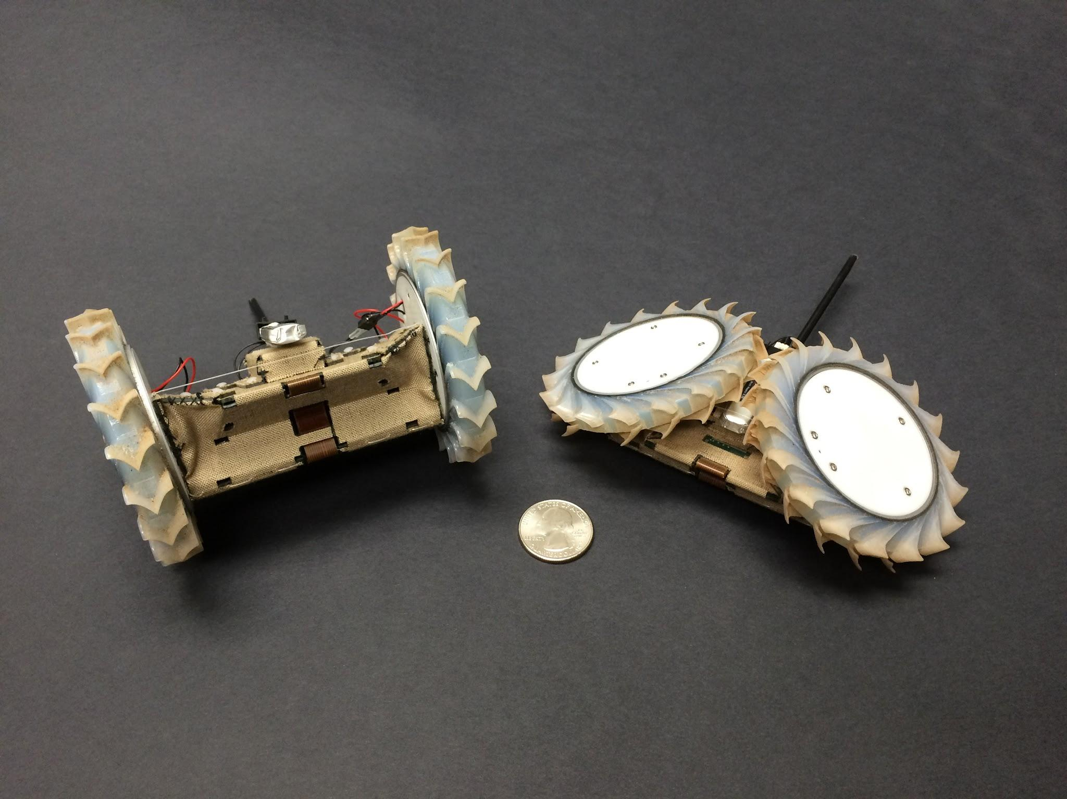
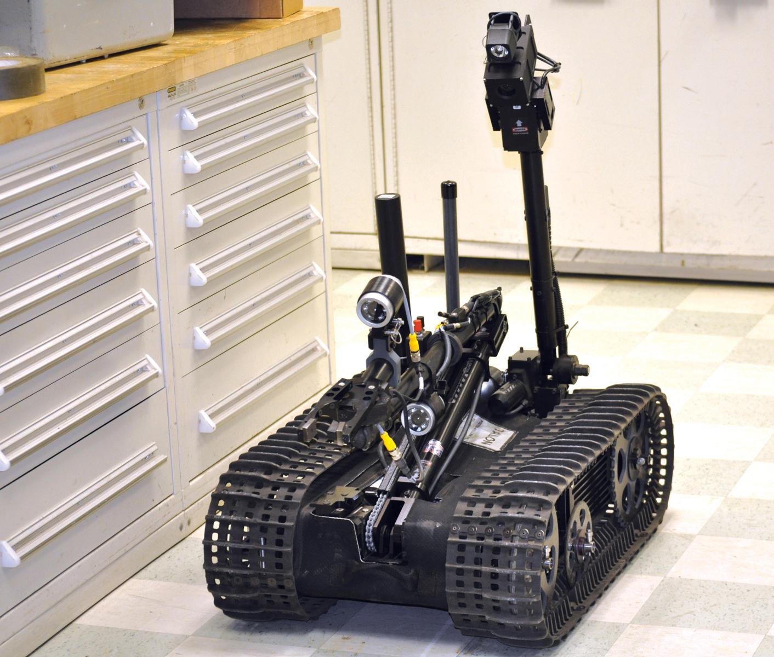
Novelty of the project(Key Innovation):
Integration of the following features together in a single body robot is the novelty in this project to the best of our knowledge:
Autonomous navigation - The robot detects the object at a distance and navigates itself to the object avoiding any collisions.
Autonomous picking - The robot uses its arm to sense the object and pick it up.
User tracking - The robot tracks the location of the user and brings the object to the user.

Slide 5
Project timeline
Week 0 - 4
Week 5- Midterm Evaluation
Midterm Evaluation - Week 8
Week 9 - Week 11
Week 12 - Week 14
Week 15 - Final Evaluation
9th Jan - 30th Jan
31st Jan - 20th Feb
21st Feb - 13th March
14th March - 27th March
28th March - 10th April
11th April - Final Evaluation
Initial planning Exploring available image processing libraries User tracking logic
Acquiring the components Final prefabrication design Fabricating the robot’s base Initialising the RasPi Making the motors controllable
Programming the User Tracking Algorithms Handling Navigation and localisation
Fabricating the arm after fetching required servos. Independent arm movement programming Attaching the arm with the rest of the bot.
Object - Arm calibration. Alternative storing mechanism. Multiple Object fetching. Handling more complexity in Object type and navigation.
Final testing of the bot. Final report and presentation preparation.

Slide 6
The work on this project has always been in progress according to the timeline specified. All the steps of the job have been fulfilled as per the deadlines and we proceeded in accordance with the plan.

Slide 7
Detailed Developments
Taking off, from where we left in the mid-term evaluation, we proceeded with the plan and integrated everything after working on every aspect as an individual module, after working on the entire pseudocode for the same.

Slide 8
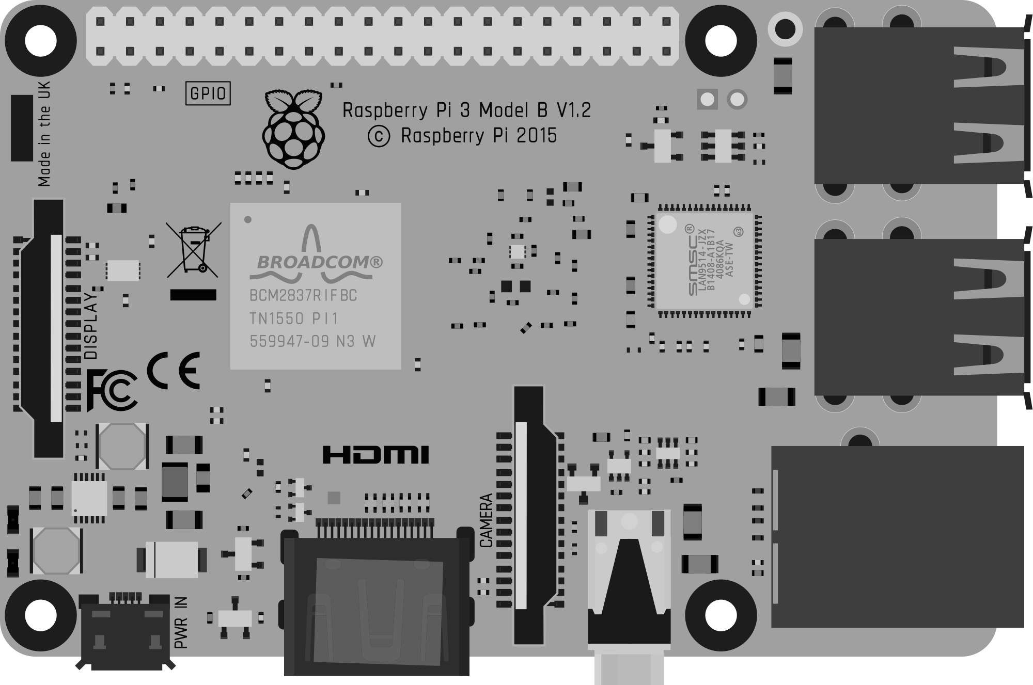
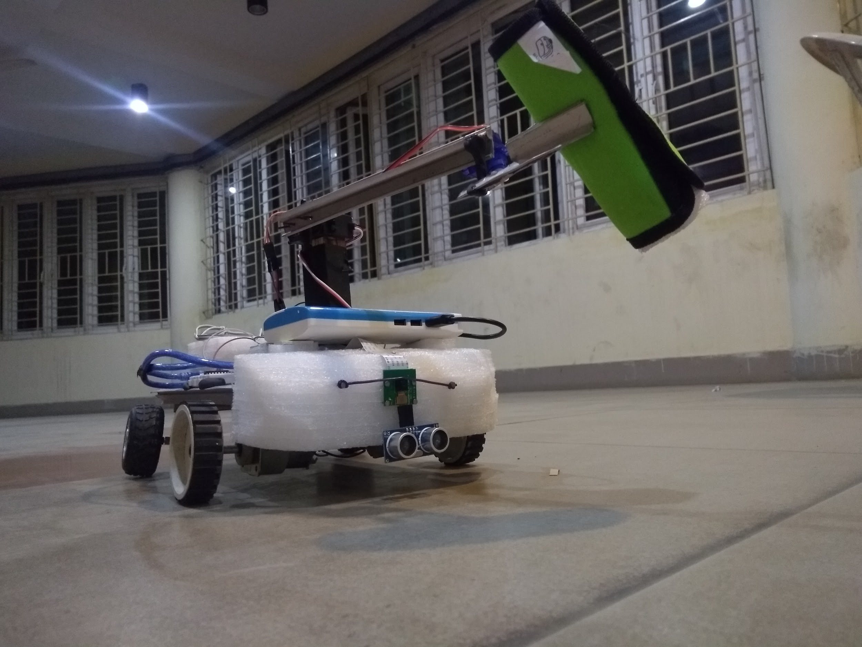
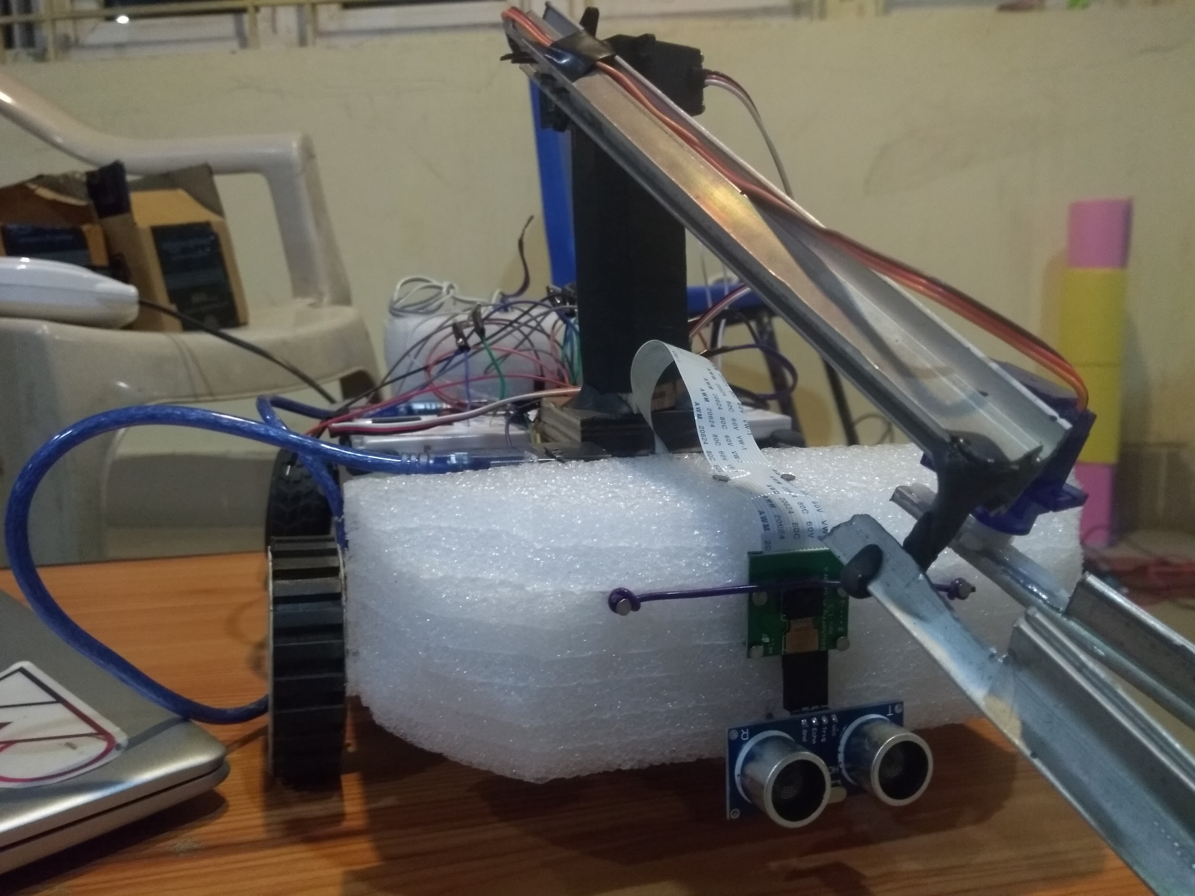
Designing of the Arm:
01
The structure of the arm:
Made of
Wood
Aluminium
Consists of one single joint connected via a metal gear SERVO motor
The claw is connected to the arm by a micro-SERVO motor to lift the object.

Slide 9
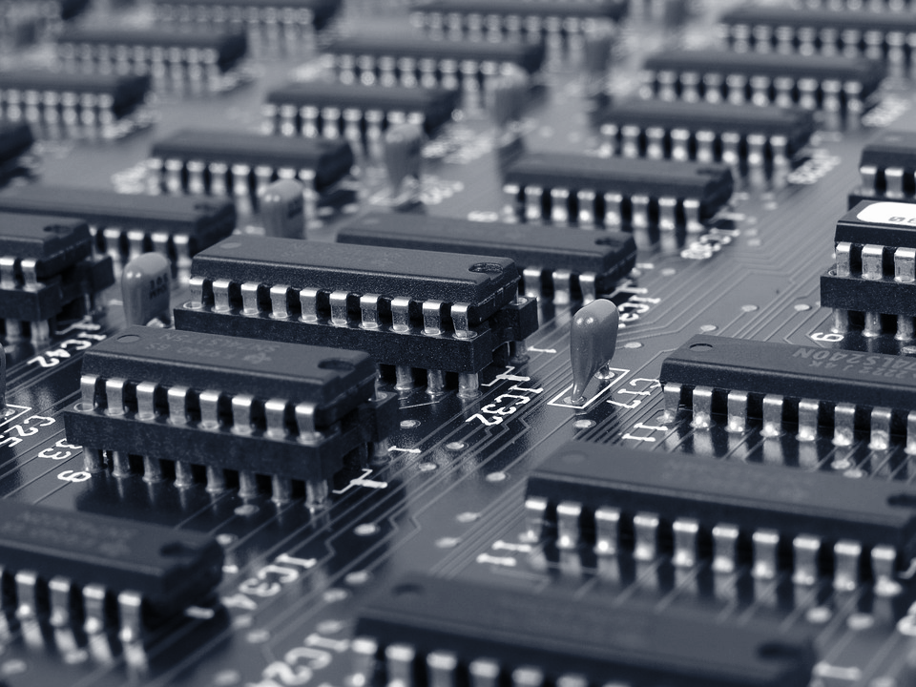
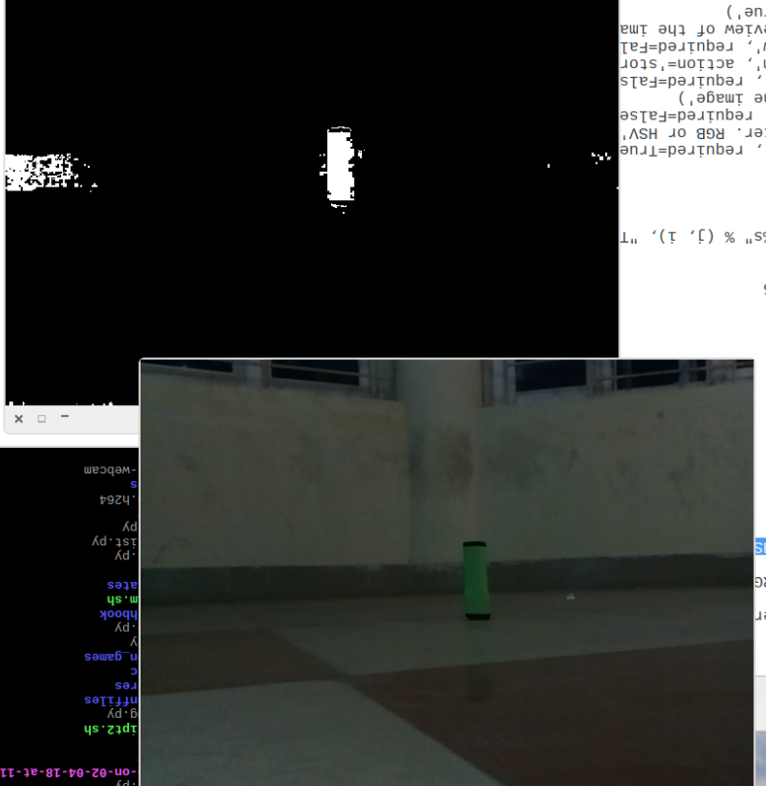
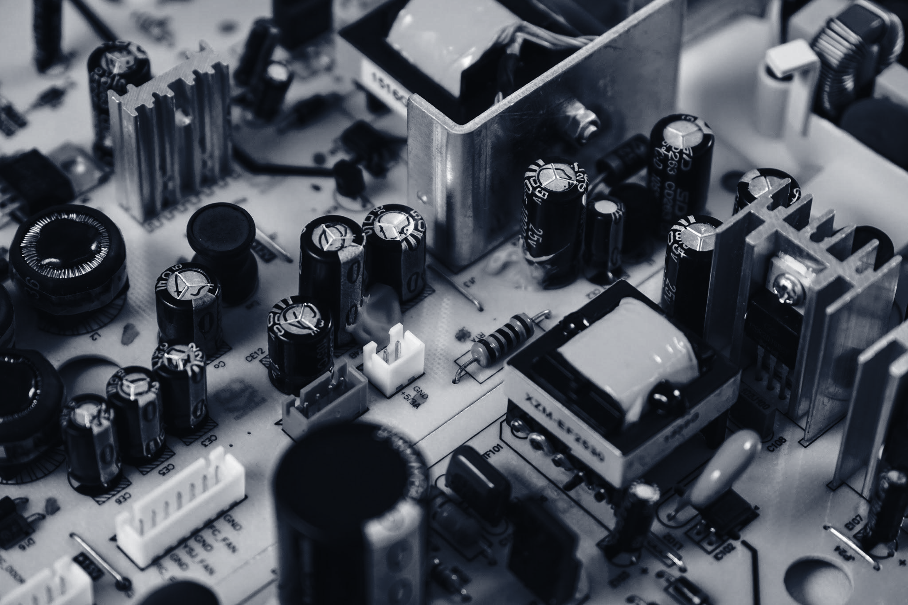
Object Detection Using Image Processing:
02
Designed the sample objects pertaining to a specific colour(green here).
The program written masks the colour and hence finds contours of the object according to the boundaries for the colour specified.
The program is run on the Raspberry Pi, from input by the Pi camera module.
ret, frame = camera.read()
hsv = cv2.cvtColor(frame, cv2.COLOR_BGR2HSV)
mask = cv2.inRange(hsv, greenLower, greenUpper)
mask = cv2.erode(mask, None, iterations=2)
mask = cv2.dilate(mask, None, iterations=2)
Cnts = cv2.findContours(mask.copy(), cv2.RETR_EXTERNAL,cv2.CHAIN_APPROX_SIMPLE)[-2]

Slide 10
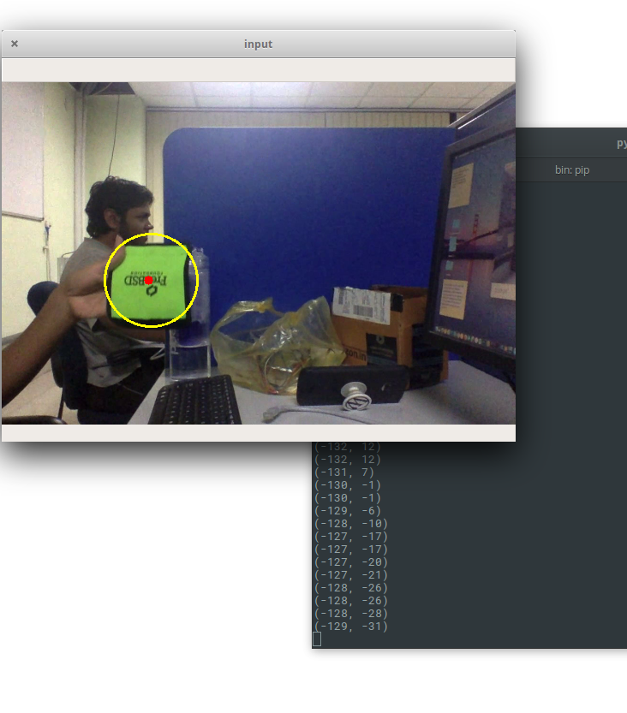
Sensing of the Object And Operation Of The Arm:
03
The Pi camera senses the object and Pi commands the Arduino to move the robot towards the object.
The ultrasonic sensor makes it stop at a specific distance and then the arm reacts.
It moves accordingly to grab the object and lifts itself

Slide 11
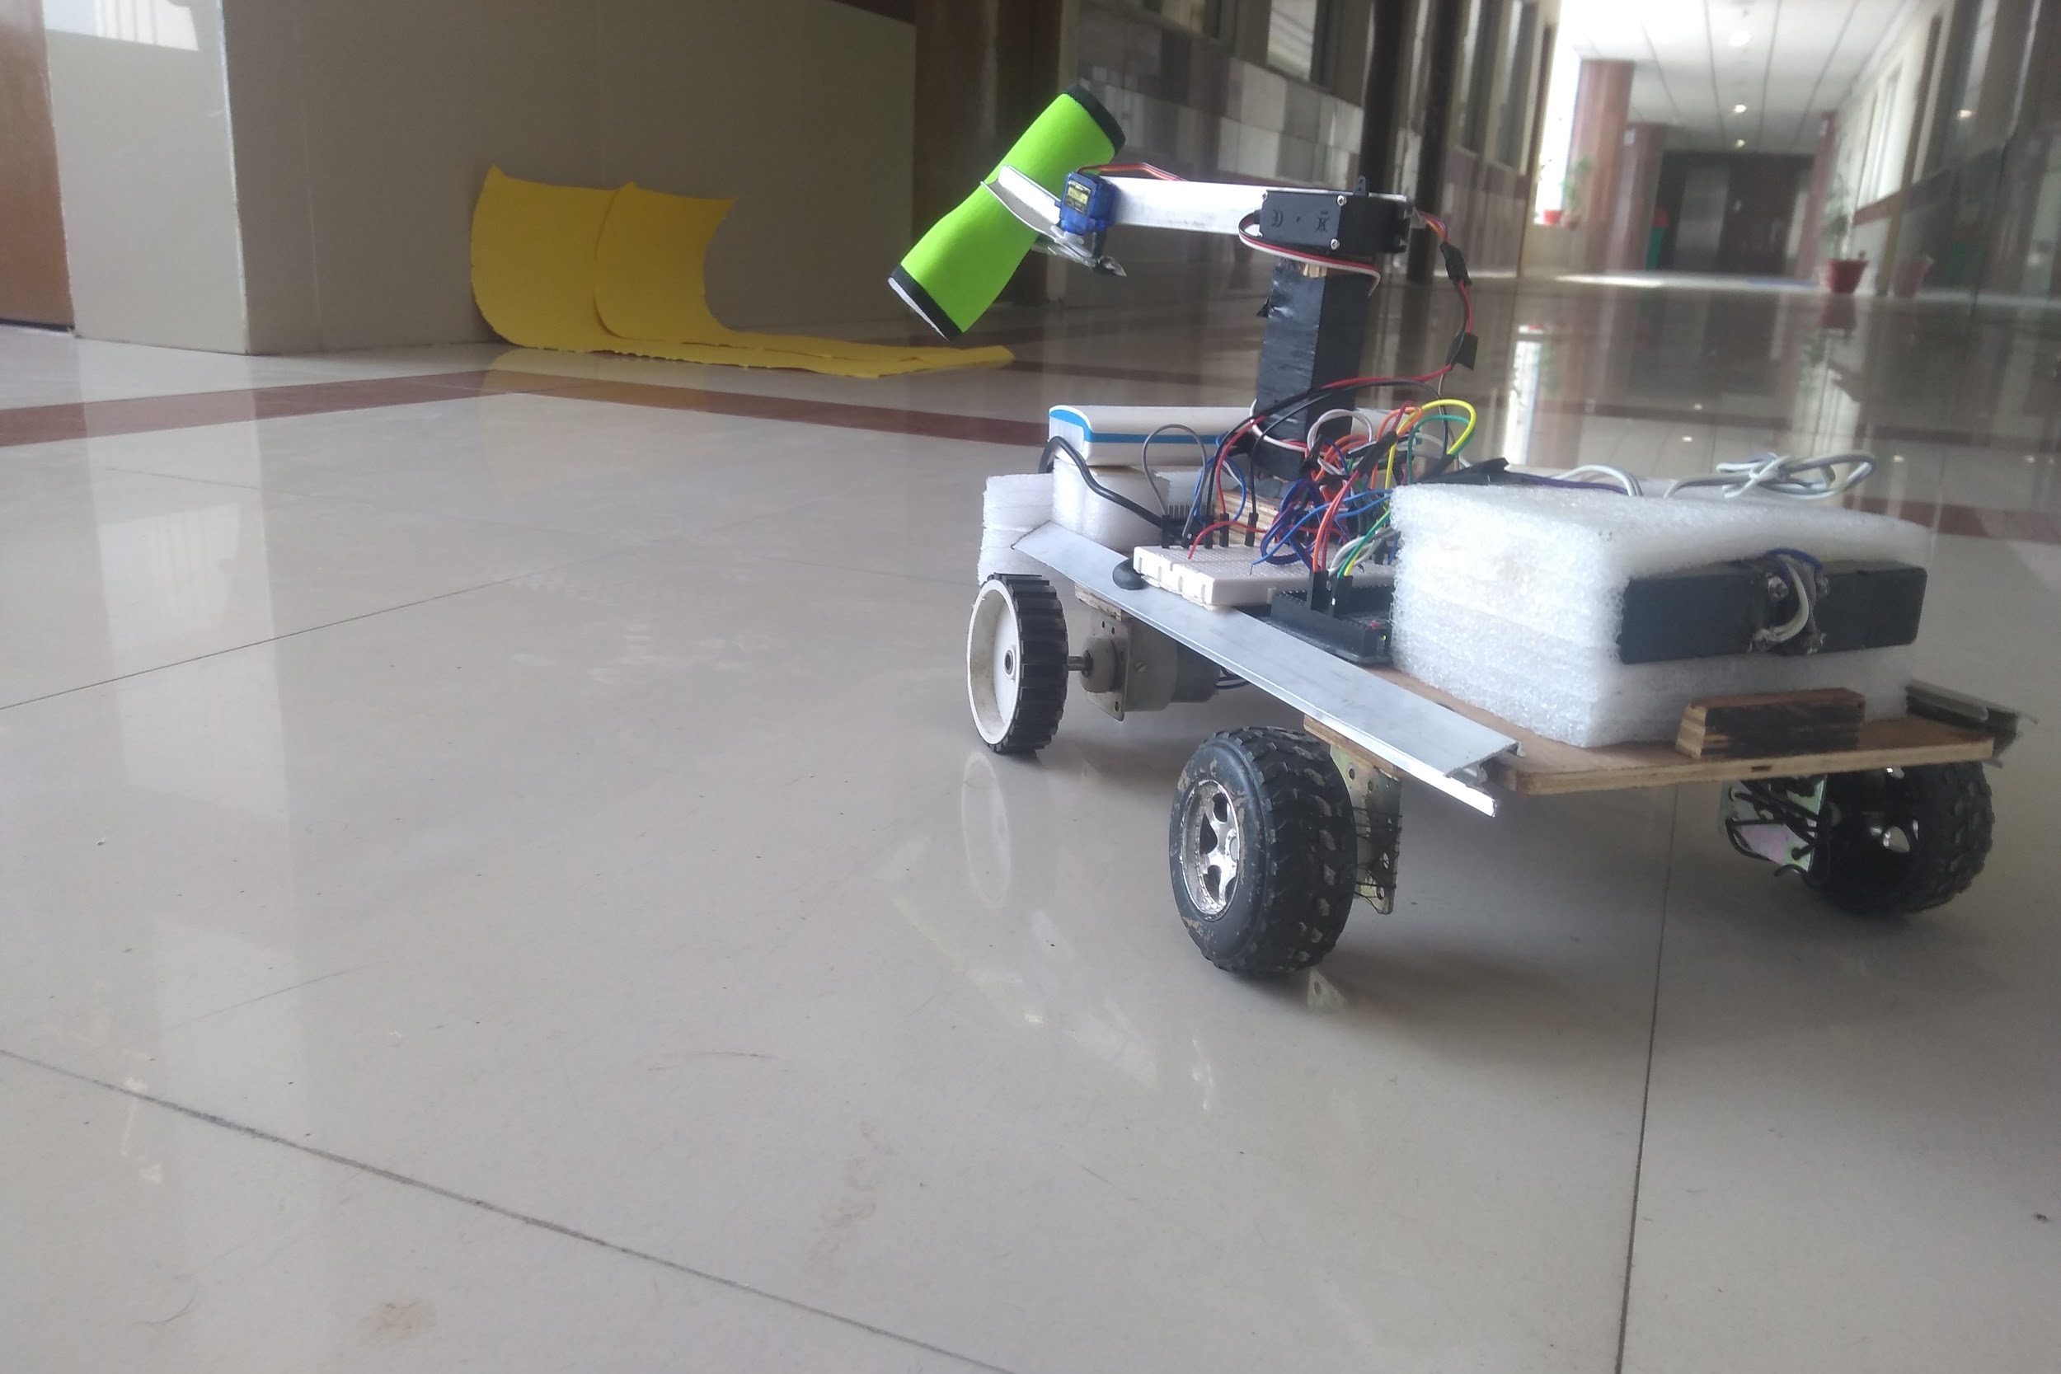
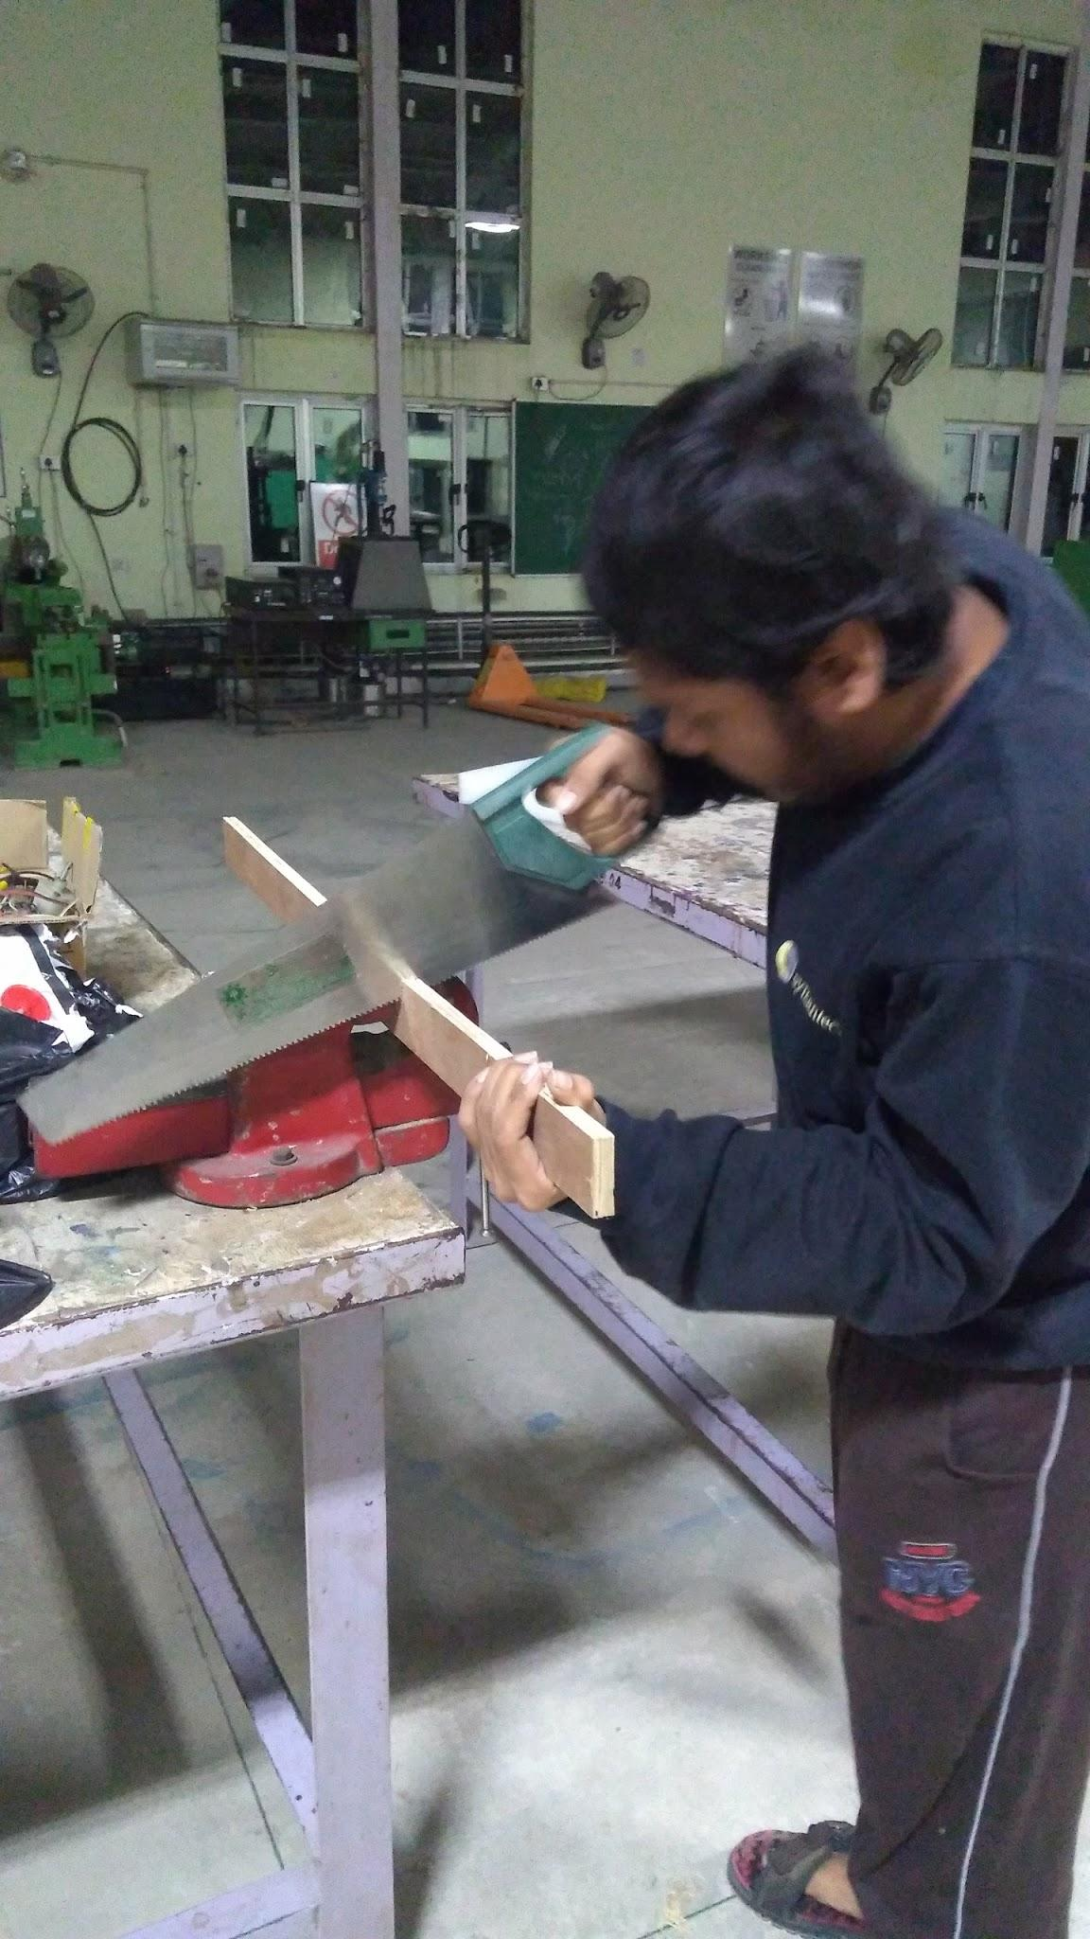
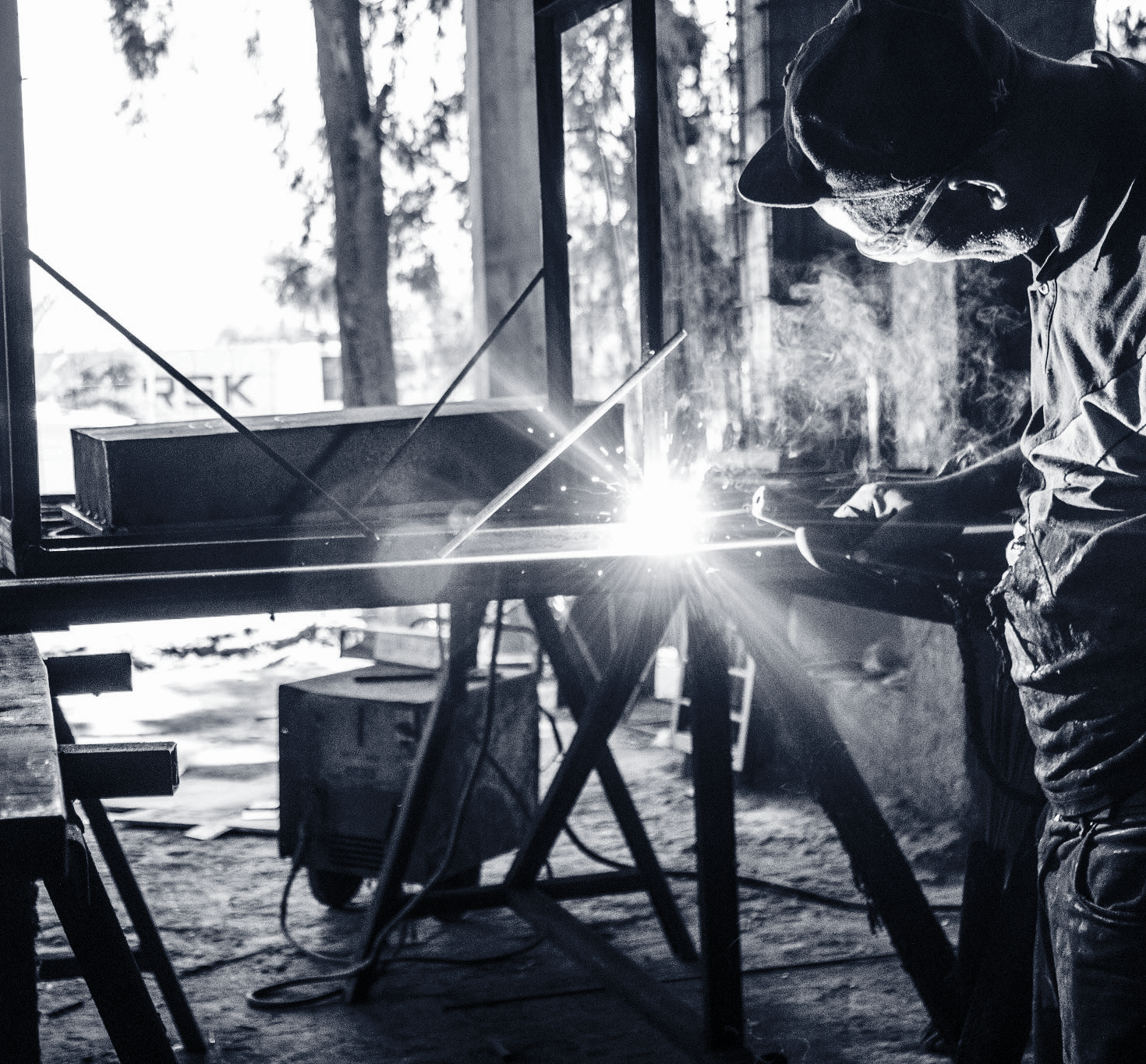
04
Exploring User Tracking:
A mechanism similar to object detection is used in user tracking.
User has a portable base station of a specific colour(yellow here).
After lifting the object the robot detects this base and moves towards it.

Slide 12
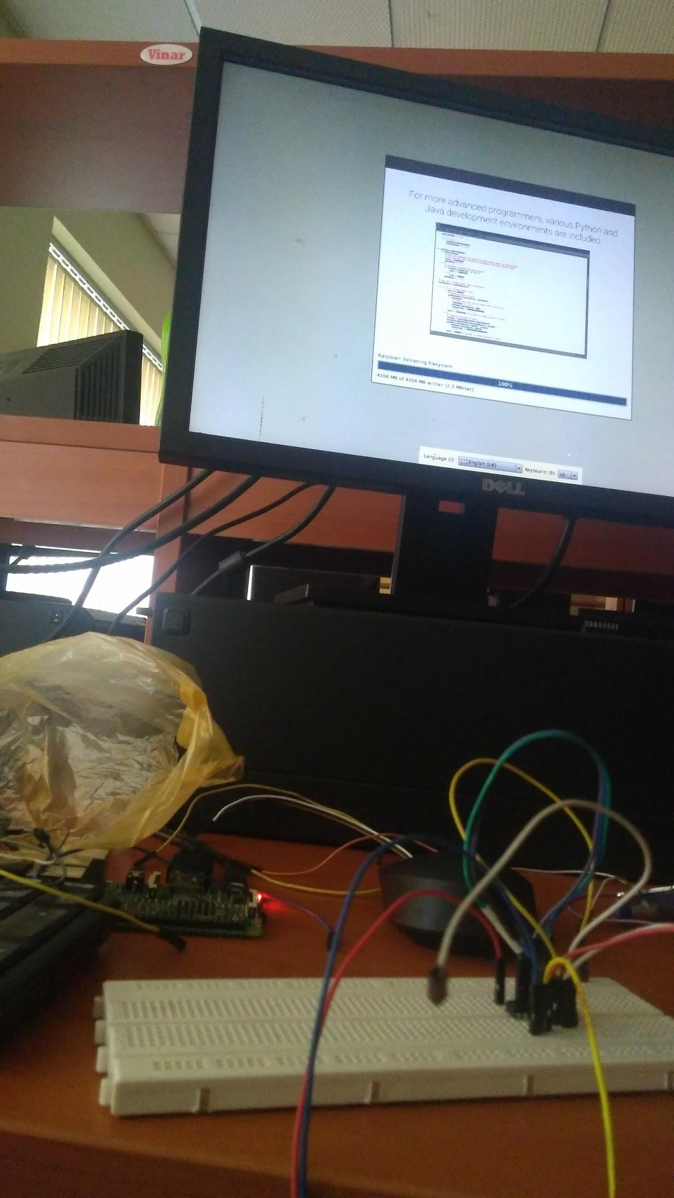
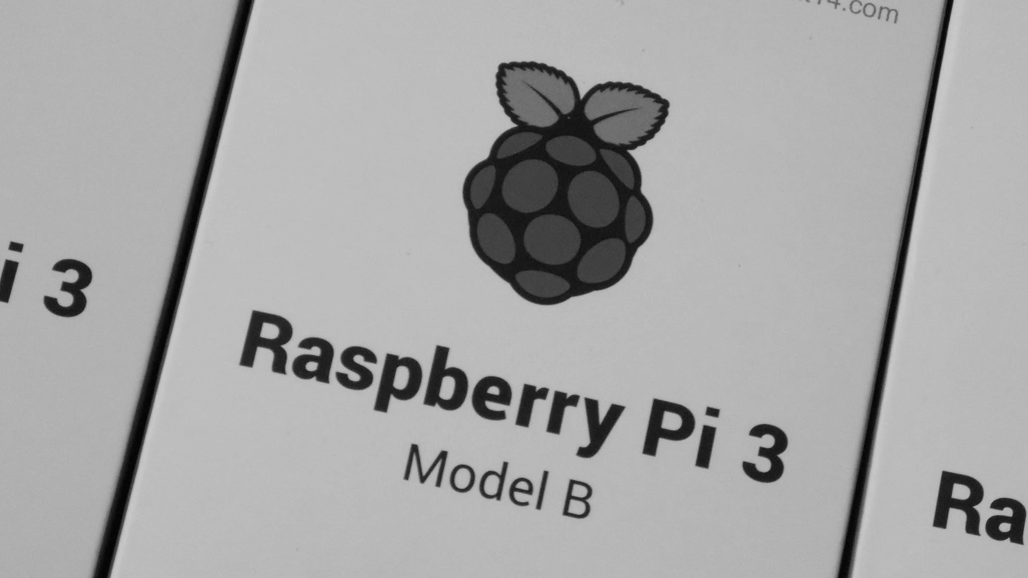
Raspberry Pi-Arduino Mega Interfacing:
05
Arduino was interfaced to work according to the commands given by the Pi as
Arduino Mega board was used for movement of the robot and controlling the SERVO motors for motion of the arm
Raspberry Pi was used for the Image Processing, it was necessary to make them work together.

Slide 13
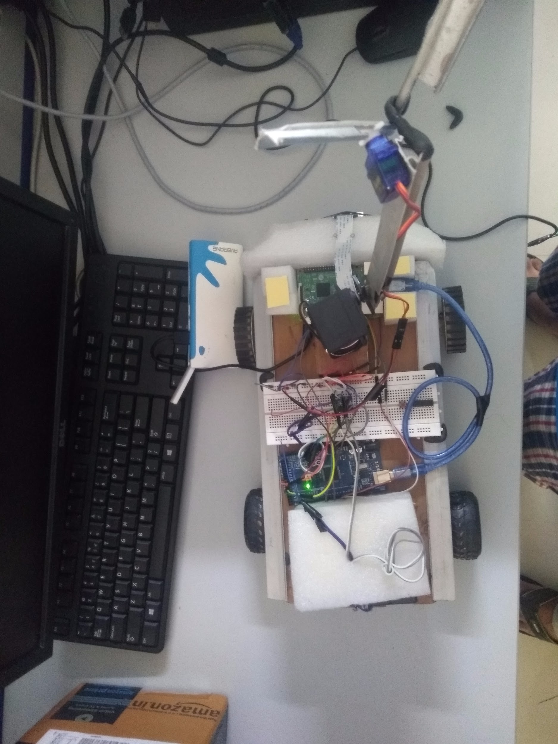
Integrating Everything Together:
06
Finally after working on separate modules as specified above, all the modules were integrated together the code sequenced according to the pseudocode as the functioning of the robot is tested rigorously.

Slide 14
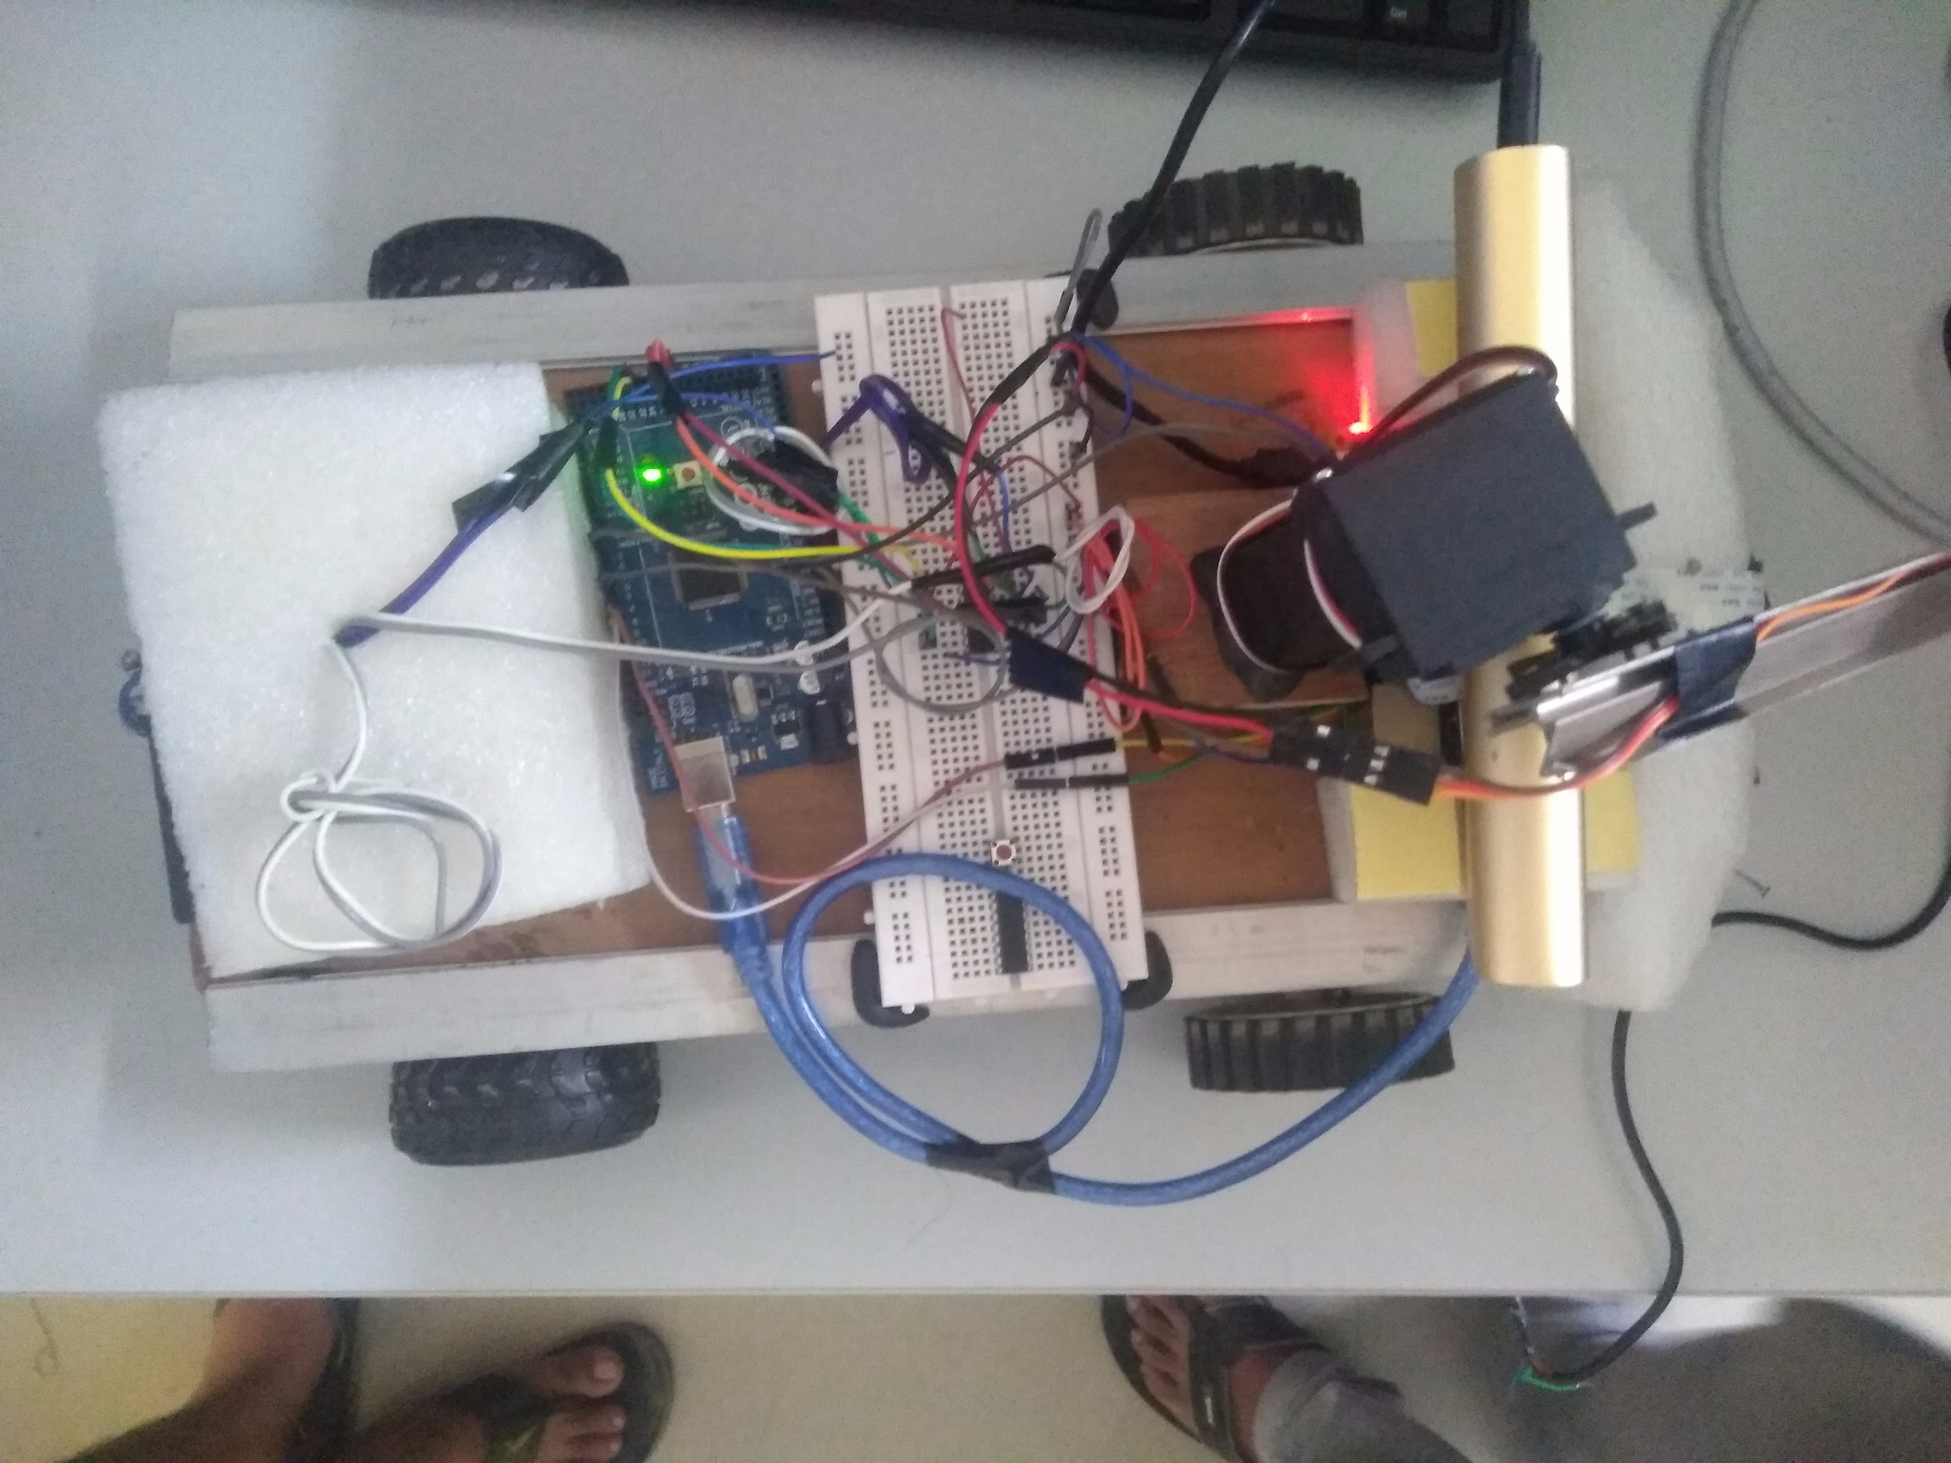
Front Wheel Drive:
The robot is powered at only the front wheels, while the back wheels give support for motion or turning, which is contrary to normal vehicles which use rear-wheel-drive-front-wheel-control or 4-wheel drive.
The reason behind this is:
As the robot is detecting an object via image processing, it would be faster to turn through at trace the object effectively, instead of a rear-wheel-drive.
Of course 4-wheel-drive makes it more easier, but the microcontroller boards and microprocessors may face surge currents if this is used.

Slide 15
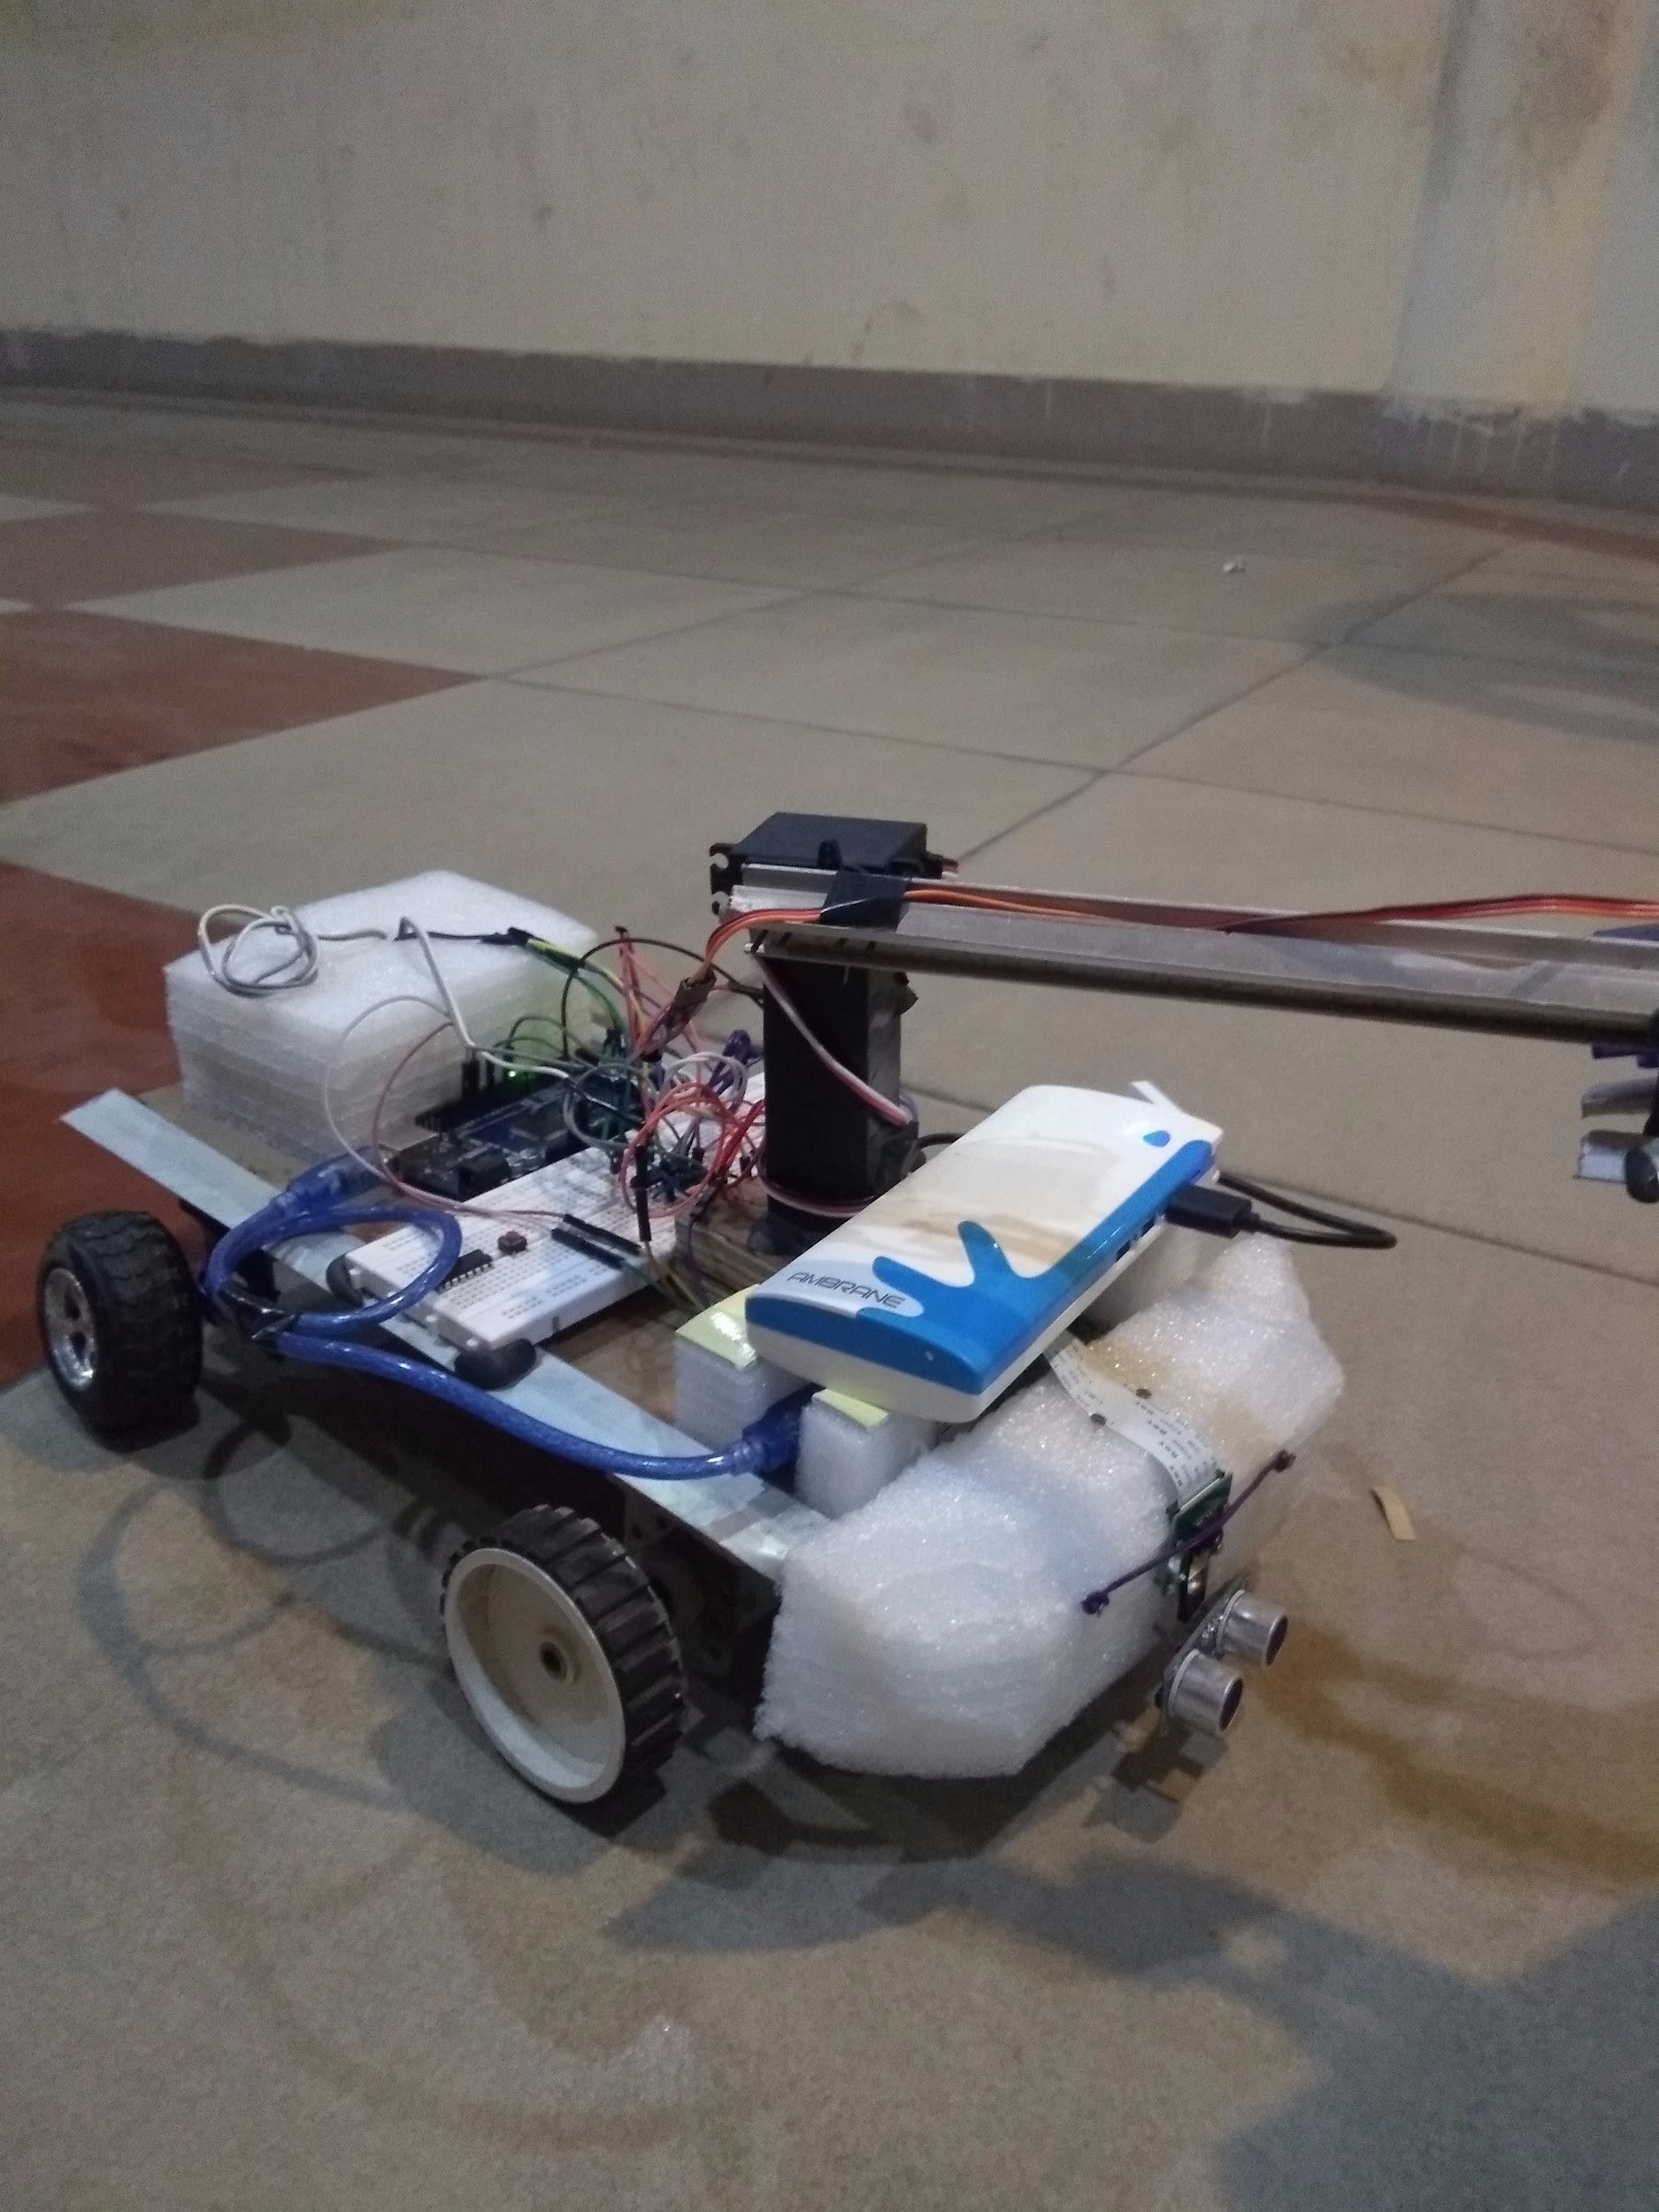
How It Finally Works
The Arduino makes the robot rotate till it detects the object
2) Once the object is detected by the Pi camera, it gives commands to the Arduino to move the robot forward to the object.

Slide 16
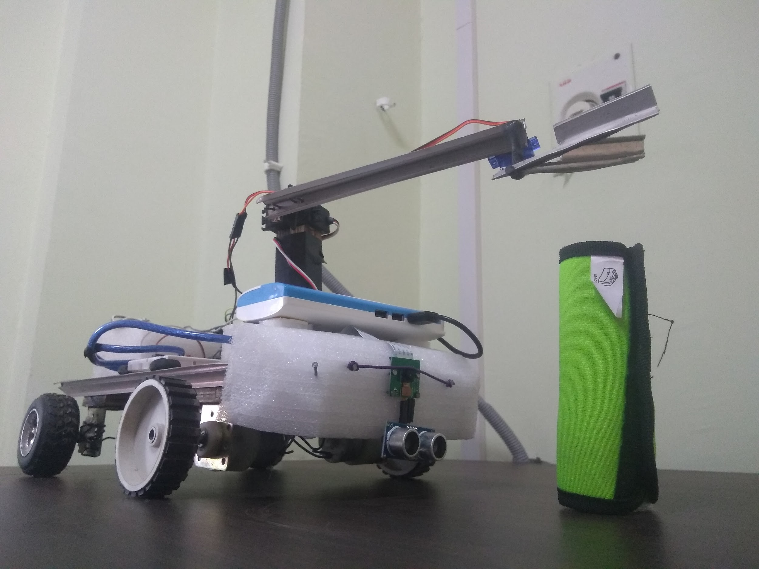
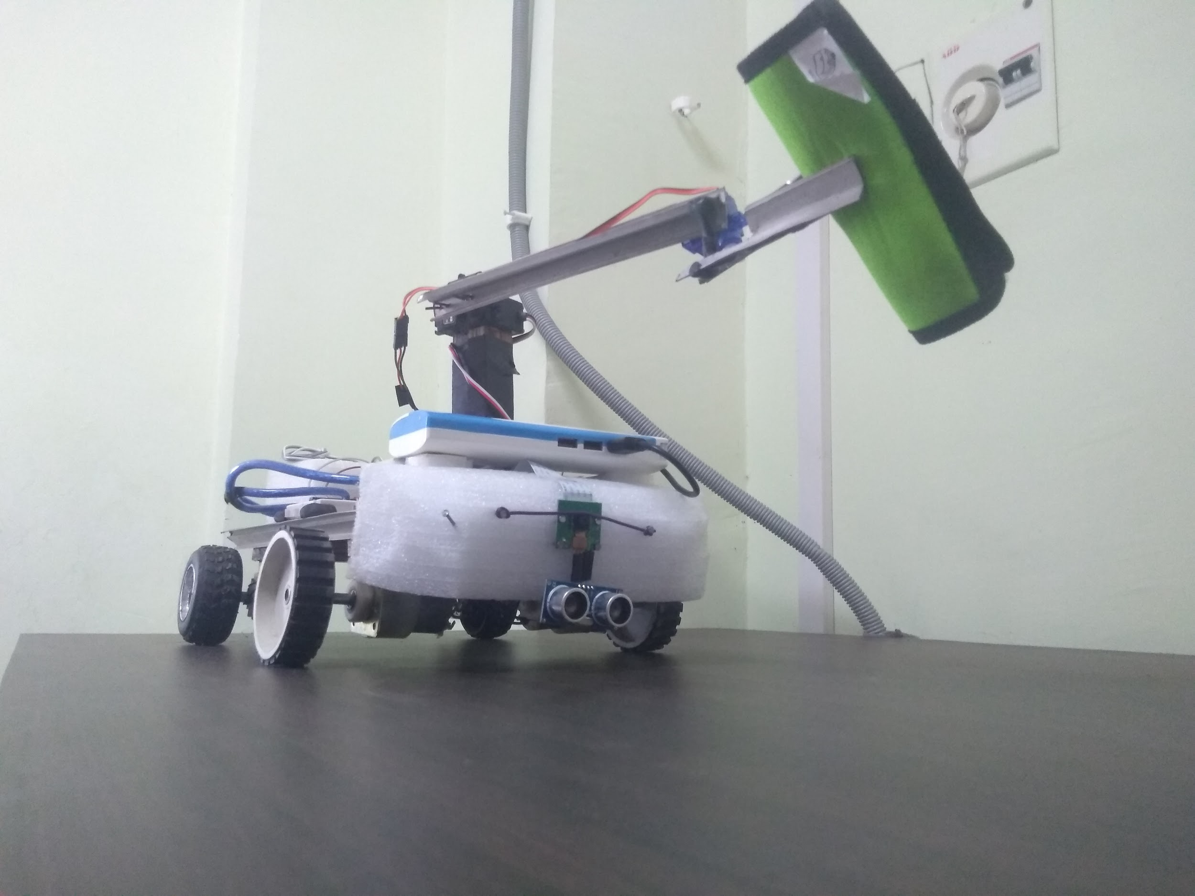
How It Finally Works
3) Once at a specific distance from the object detected by the ultrasonic sensor, it stops.
4) Then the Pi commands the Arduino to lower the arm and grip the object. Once the object is held the arm is lifted.

Slide 17
How It Finally Works
5) Then the Arduino makes the robot rotate till it detects the base.
6) Once the base is detected by the Pi camera, it gives commands to the Arduino to move the robot forward to the base.

Slide 18
Challenges Faced:
There were many hurdles we faced during the entire journey of the making of this project. Some of them are as follows:
Malfunctioning of 2 Raspberry Pi boards
First suddenly stopped working(maybe due to a surge current)
In second, malfunction of GPIO pins
Malfunctioning of 3 to 4 L293D ICs, both motor driver boards and old jumper wires.
Turning of the robot using only front wheel drive.
Precise bot alignment with arm.

Slide 19
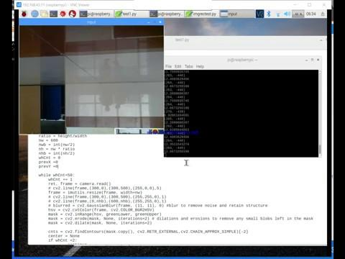
Image Processing Anomalies

Slide 20
Image Processing Anomalies
Different lighting conditions based on environment and timing requires repeated recalibration.
Pi camera grabs some initial garbage image frames
Non critical HSV boundaries treat random objects and noise as objects. (numpy std dev, boundingRect)
Noise in video feed results in ambiguous object detection and flickering centroid coordinates.

Slide 21
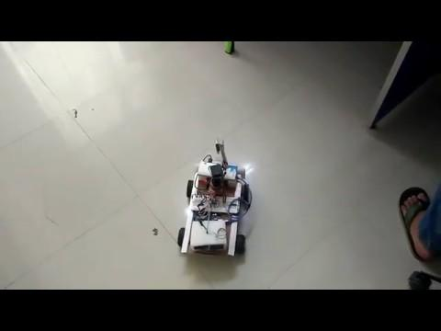
Demo:

Slide 22
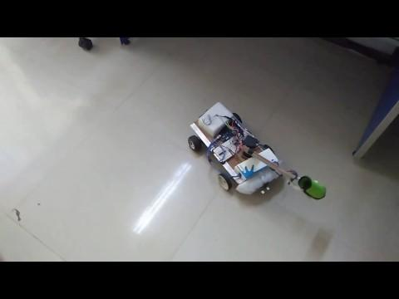
Demo:
https://drive.google.com/drive/folders/1xgfc_lOeXdo8syYNcQYSJ-kQ41ESCYdV?usp=sharing

Slide 23
Future Prospects
Idea can be developed to great extent.
Using Indoor Localisation objects can be fetched from rooms other than the room where the user is currently located.
Further integration with AI would enable the robot to fetch objects which it has never seen before.
Exploration and rescue missions could be aided using a more developed version of this idea.
Extreme advancement would result in automated intercity transport, improving the shipping industry’s efficiency and saving human effort.

Slide 24
Market Potential
This idea on further development would have a great market potential as it is a domestic help which would make the life of many easy and they can focus on other activities where more human input is required.
People with limited mobility can be assisted using this idea, as getting objects fetched by a robot would make their life much easier.
Exploration industry will show a great interest in further development, as it can assist in collecting samples from places inaccessible to humans.
Further similar idea can be implemented to a flying device like a drone which can further improve the exploration aspect of the robot, which again gives a high market potential.

Slide 25
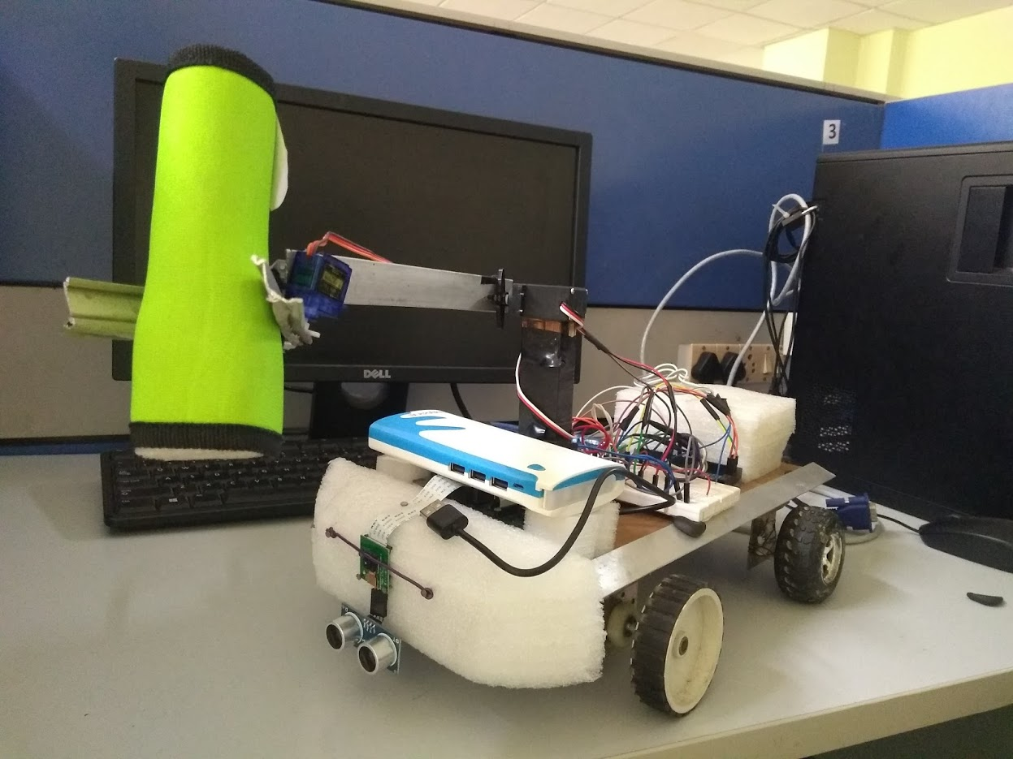
Autonomous Helper Bot
Tameesh Biswas
Parth Kulkarni

Slide 26
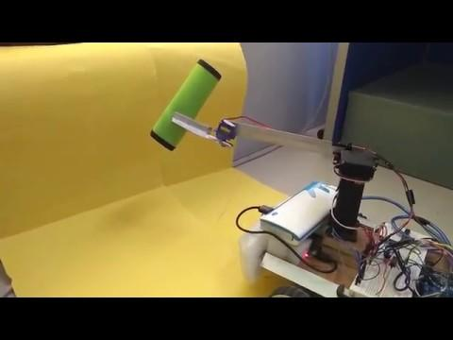
Thank you!

